Slide 1



Open Science: what’s in it for researchers?
Joy Davidson,
Digital Curation Centre (DCC)
FOSTER Project
Notes:
In a bid to improve research integrity and to maximize public investment, researchers are increasingly under pressure to share their findings with other researchers and with the general public. Rather than seeing this move towards Open Science as a burden, emerging researchers should embrace this new, transparent and more networked way of performing research and creating societal value. Indeed, Open Science offers a range of potential and measurable benefits for both researchers and the institutions that employ them. However, to realise this potential, researchers will need new skills that enable them to undertake a broader range of tasks along the entire research lifecycle - from undertaking new means of collaboration, implementing data management and sharing strategies, to understanding how to amplify and monitor their research profile and its impact.
The session will introduce participants to the potential benefits associated with adopting an Open Science approach and highlight some of the tools and best practices that are available now to help researchers to make the most of their research.

Slide 2
What is Open Science, RDM and data curation?
“the active management and appraisal of data
over the lifecycle of scholarly and scientific interest”
Data have importance as the evidential base
of scholarly conclusions
Curation is part of good research practice

Slide 3
Benefits and drivers
– the UK policy landscape

Slide 4
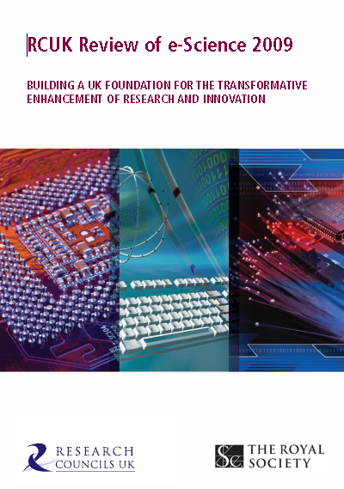
“Data sets are becoming the new instruments of science”
Dan Atkins, University of Michigan

Slide 5

Expectations of public access
“Publicly funded research data are a public good, produced in the public interest, which should be made openly available with as few restrictions as possible in a timely and responsible manner that does not harm intellectual property.”
RCUK Common Principles on Data Policy
http://www.rcuk.ac.uk/research/Pages/DataPolicy.aspx

Slide 6
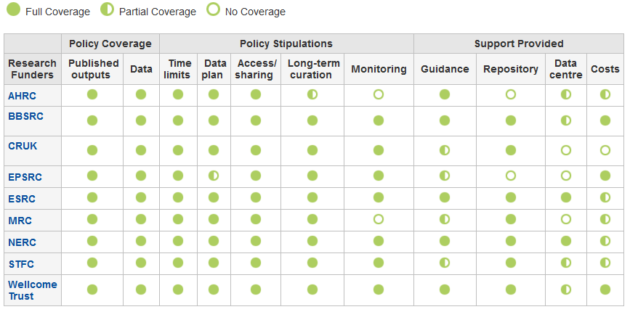
Research funder data policies
www.dcc.ac.uk/resources/policy-and-legal/ overview-funders-data-policies

Slide 7

Ultimately funders expect:
timely release of data
  once patents are filed or on (acceptance for) publication
open data sharing
  minimal or no restrictions if possible
preservation of data
  typically 5-10+ years if of long-term value
See the RCUK Common Principles on Data Policy:
www.rcuk.ac.uk/research/Pages/DataPolicy.aspx

Slide 8

“Research organisations will ensure that effective data curation is provided throughout the full data lifecycle, with ‘data curation’ and ‘data lifecycle’ being as defined by the Digital Curation Centre. The full range of responsibilities associated with data curation over the data lifecycle will be clearly allocated...”
...institutional responsibility
www.epsrc.ac.uk/about/standards/researchdata/Pages/expectations.aspx

Slide 9
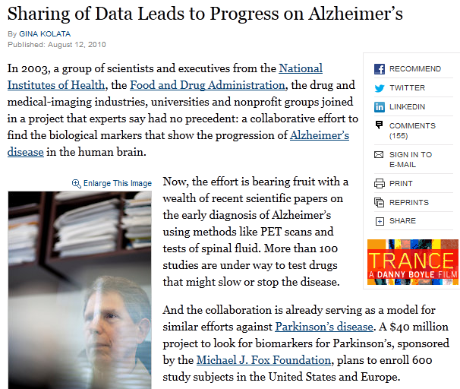
Benefits of data sharing (1)
“It was unbelievable. Its not science the way most of us have practiced in our careers. But we all realised that we would never get biomarkers unless all of us parked our egos and intellectual property noses outside the door and agreed that all of our data would be public immediately.”
Dr John Trojanowski, University of Pennsylvania
www.nytimes.com/2010/08/13/health/research/13alzheimer.html?pagewanted=all&_r=0
    ... scientific breakthroughs

Slide 10
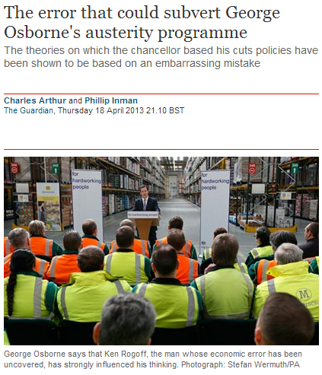
Benefits of data sharing (2)
“It was a mistake in a spreadsheet that could have been easily overlooked: a few rows left out of an equation to average the values in a column.
The spreadsheet was used to draw the conclusion of an influential 2010 economics paper: that public debt of more than 90% of GDP slows down growth. This conclusion was later cited by the International Monetary Fund and the UK Treasury to justify programmes of austerity that have arguably led to riots, poverty and lost jobs.”
    ... validation of results
www.guardian.co.uk/politics/2013/apr/18/uncovered-error-george-osborne-austerity

Slide 11

Benefits of data sharing (3)
“There is evidence that studies that make their data available do indeed receive more citations than similar studies that do not.”
Piwowar H. and Vision T.J 2013 "Data reuse and the open data citation advantage“ https://peerj.com/preprints/1.pdf
... more citations
9% - 30% increase

Slide 12
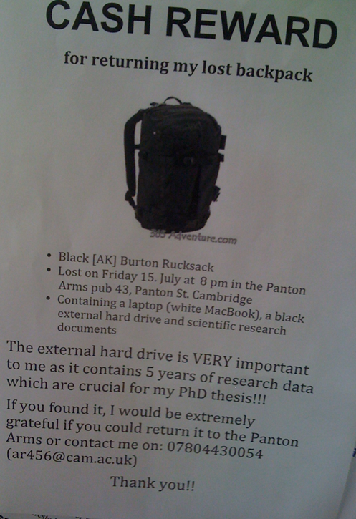
Direct benefits to individuals
Why YOU need a Data Management Plan
http://blogs.ch.cam.ac.uk/pmr/2011/08/01/why-you-need-a-data-management-plan

Slide 13
Data Management Planning
Data Sharing
Data Management Planning

Slide 14
What is data sharing?
  “… the practice of making data used for scholarly
  research available to others.” [Wikipedia]
Who’s involved?
  the data sharer
  the data repository
  the secondary data user
  support staff
  research participants
  commercial partners

Slide 15
Managing restrictions on sharing
  Ethics
  Balance data protection with data sharing
  Informed consent – cover current and future use
  Confidentiality – is anonymisation appropriate?
  Access control – who, what, when?
  IPR
  Clarify copyright before research starts
  Consider licensing options e.g. Creative Commons

Slide 16
How to share research data
Use appropriate repositories and data catalogues
  http://databib.org
  http://www.re3data.org/
  Jisc/DCC research data registry (coming soon!)
License the data so it is clear how it can be reused
  www.dcc.ac.uk/resources/how-guides/license-research-data
Make sure it’s clear how to cite the data
  http://www.dcc.ac.uk/resources/how-guides/cite-datasets
Consider publishing a data paper based on your DMP http://metajnl.com/

Slide 17
Data Management Planning

Slide 18
What is a DMP?
A short plan that outlines
what data you will create and how
how you will manage it
(storage, back-up, access…)
plans for data sharing and preservation
DMPs are often submitted as part of grant applications, but are useful whenever you’re creating data.
Create
Document
Use
Share
Preserve
Store

Slide 19
Why develop a DMP?
to help you manage and share your data
to provide guidelines for everyone to work to
to anticipate and avoid problems e.g. data loss
to avoid duplication, data loss & security breaches
to comply with funders requirements...

Slide 20


Data sharing plan
Covering:
Dataset
Standards
Metadata
Preservation
Data sharing
  method
  timescale
  restrictions
  agreements
Data Mgmt Plan
Covering:
Data
Data sharing
  when?
  where?
  how?
  restrictions?
Preservation
Resources
Data Mgmt Plan
Covering:
Data
Data collection
Management
Security
Data sharing
Responsibilities
Related policies
Admin details

Slide 21

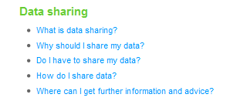
Some funders don’t ask for a DMP but still have expectations
Researchers applying for an HTA grant should consider data sharing in their proposals
Don’t prescribe sharing but expect researchers to consider and plan for it as appropriate
Follow DOH Research Governance Framework and MRC guidelines for Good Research Practice
www.hta.ac.uk/funding/troubleshooting/index.html
Notes:
In the FAQs for the Health Technology Assessment Programme, NHS clarifies that...

Slide 22
Data Discovery and Reuse

Slide 23








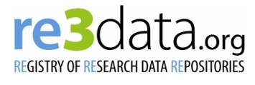

Archiving – external data centres
  Structured databases
  Research funders’ data centres…
Registries of international
data centres
Disciplinary& community initiatives
Notes:
23

Slide 24




Institutional data repositories
Not intended to replace national, subject or other established data repositories
Acknowledge hybrid environment
http://datashare.is.ed.ac.uk
Research Data at Essex and
DataPool at Southampton
www.dspace.cam.ac.uk
  https://databank.ora.ox.ac.uk
Notes:
24

Slide 25
Data catalogues
Oxford is developing its DataFinder tool http://blogs.it.ox.ac.uk/damaro
Research Data @ Essex has developed a profile based on DataCite, Inspire and DDI standards www.data-archive.ac.uk/ media/395364/rde_march2013_repositoryoutputs.pdf
C4D is developing a research data extension to the CERIF standard - http://cerif4datasets.wordpress.com
CKAN is being explored by various projects http://ckan.org

Slide 26
Tools and resources

Slide 27
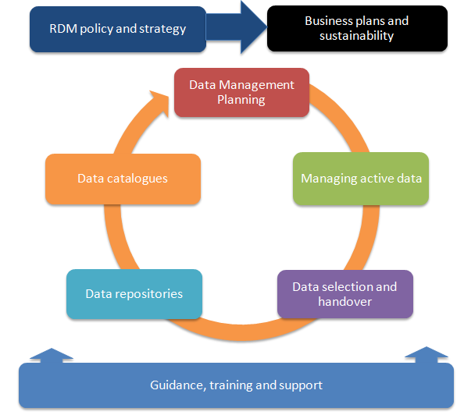
Components of RDM services

Slide 28
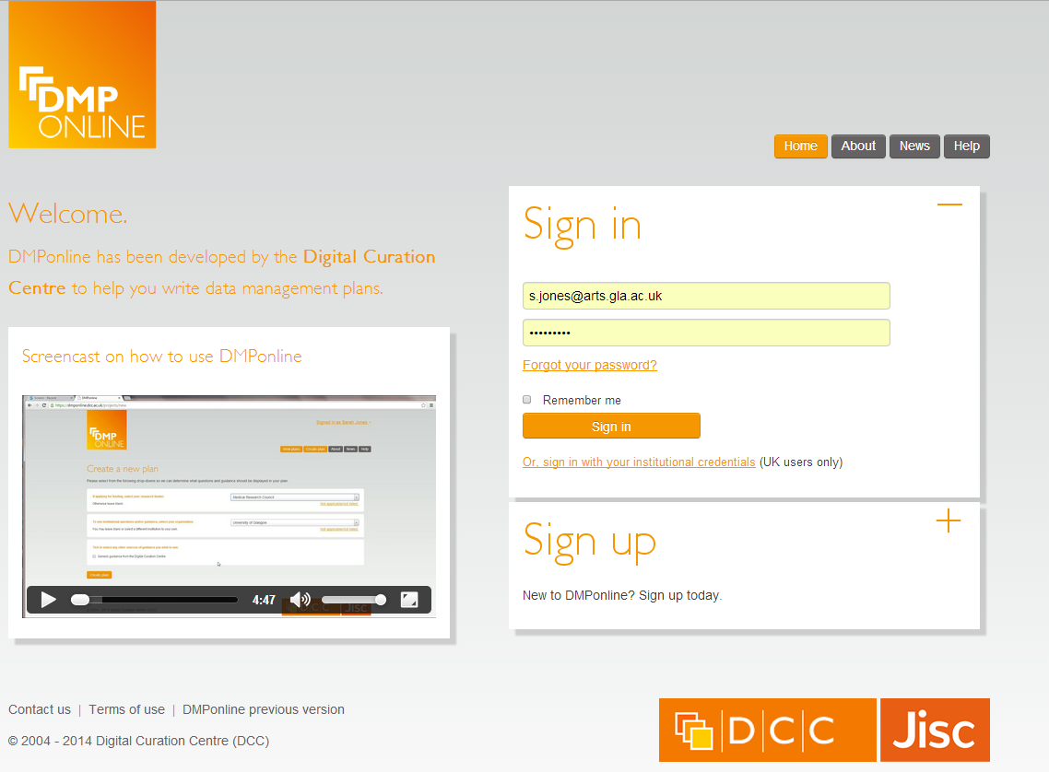
DMPonline
https://dmponline.dcc.ac.uk

Slide 29
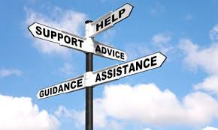

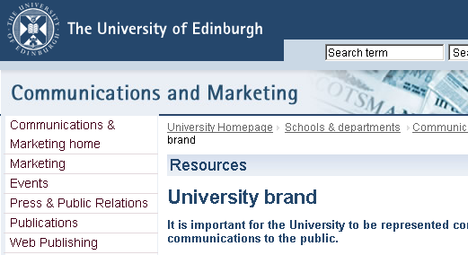
Institutions can customise DMPonline
Profile local support via custom guidance and boilerplate text
Add your logo, URL etc
Select / write desired questions
www.dcc.ac.uk/news/customising-dmponline

Slide 30
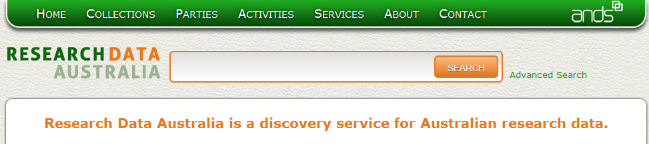
Research Data Registry pilot
aim is to improve data discovery and provide a national level service
aggregate metadata relating to data collections or datasets held in UK HEIs and subject data centres
trialling ANDS Research Data Australia

Slide 31
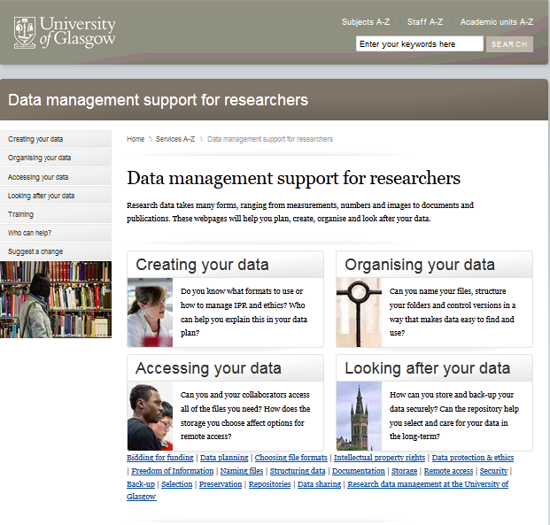
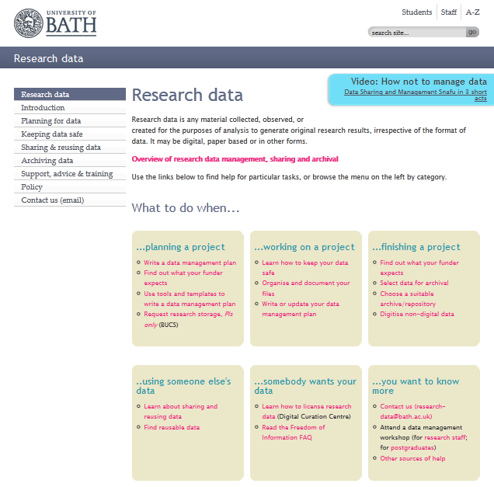
Guidance webpages
www.gla.ac.uk/datamanagement
www.bath.ac.uk/research/data

Slide 32
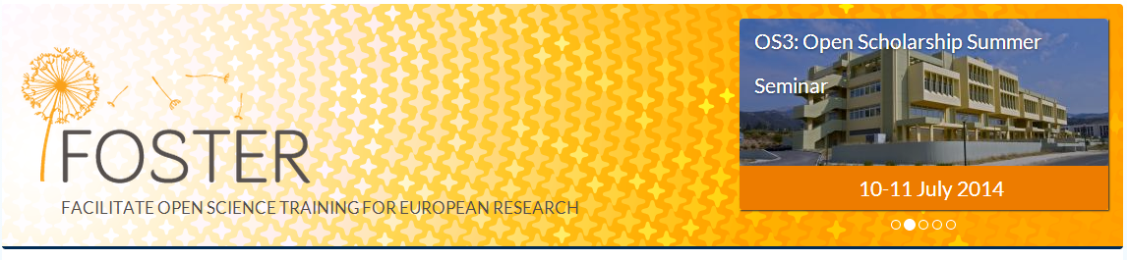
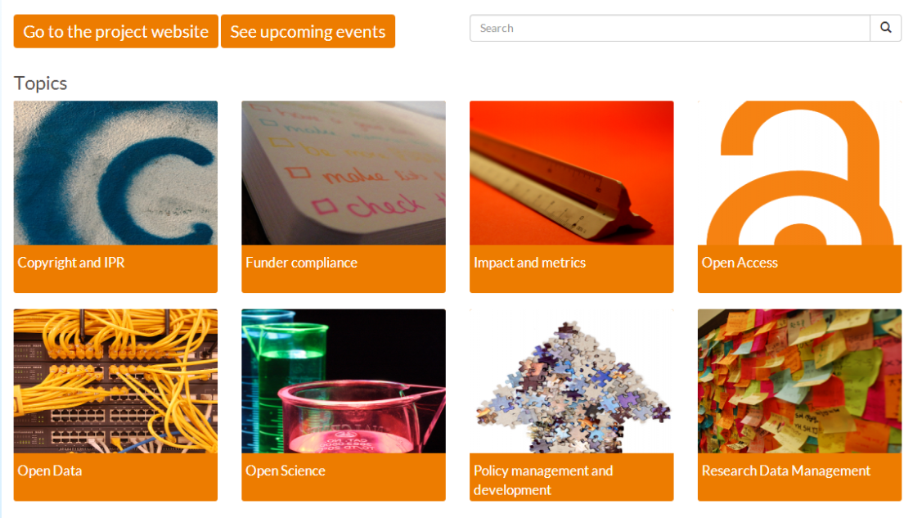
Guidance and tools
http://www.fosteropenscience.eu/
Notes:
Open Access and Open Science principles are an essential part of knowledge creation and sharing. They directly support the researchers need for greater impact, optimum dissemination of research, while also enabling the engagement of citizen scientists and society at large on societal challenges.
The FOSTER project aims to set in place sustainable mechanisms for EU researchers to FOSTER OPEN SCIENCE in their daily workflow, thus supporting researchers optimizing their research visibility and impact, the adoption of EU open access policies in line with the EU objectives on Responsible Research & Innovation.

Slide 33

Thanks – any questions?
http://www.dcc.ac.uk
http://www.fosteropenscience.eu

